Slide 1

Case Study- WineExpress
How much attention does a company pay to it’s website page? Can a few changes lead to an increase in sales and revenue? Seems rare but here at WineExpress.com we will see how they increased their sales and revenue by modifying the page.

Slide 2

About the Company
WineExpress.com is the exclusive wine shop partner of The Wine Enthusiast catalog and website, which have been providing quality wine accessories and storage for 40 years. During that time they've served millions of satisﬁed customers and built a loyal following of avid wine lovers. It's only natural then for them to have teamed up with a great wine shop to bring their customers ﬁrst quality wines at value prices. The most trafficked page on their website was “wine of the day” which features a single wine option that ships for just 99 cents. They were able to drive traffic to the page through an opt-in email list and site navigation. The page’s central focus, aside from the featured product, is a virtual wine tasting video with the company’s highly regarded Wine Director which is director of the company.

Slide 3
The Approach to Change
Although the Wine of the day page converted well the founders felt there still can be a vital improvement. Although they were faced with the common challenge many e-commerce websites face from time to time. Optimizing the balance between sales transactions and optimizing overall revenues. Focusing too much on sales conversions may negatively impact the bottom line if the average order size drops in the process.
WineExpress.com engaged conversion optimization agency WiderFunnel Marketing, developed and executed a strategy for the “Wine of the Day” page to increase revenue as well as sales. WiderFunnel went for the A/B testing and developed and tested 3 design variations, aiming mostly at testing different layout approaches. With a few changes in each layout, they wanted to check which layout will generate the most traffic. This type of testing called A/B testing is usually done by companies to check whether their model will work or not.

Slide 4
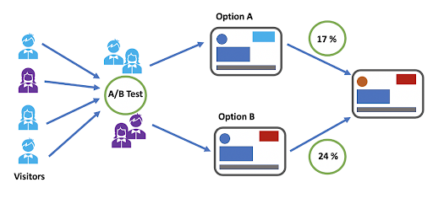
The diagram here represents how basically the A/B Testing method works in Business Analytics.

Slide 5
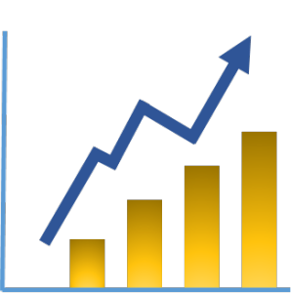
Results of the New Approach
At the end of the testing, one layout was the clear winner “We found that placing the video above the fold was a key element in the success of the new page,” says Chris Goward, CEO of WiderFunnel. “The eye flow of the new layout also improved clarity, with fewer distracting elements that could draw you away from purchasing.” This significant change led to a 41% increase in revenue per visitor “Conversion also went up,” says Chris Goward, CEO of WiderFunnel, “but the key here is that revenue per visitor went up substantially. A lot of e-commerce vendors focus too much on conversion. For WineExpress.com the success is that people bought substantially more product.”

Slide 6
Summary of the Case Study
Wineexpress.com wanted to increase revenue and sales on their website. They did A/B testing to determine which layout will be the best for the company. The model won and brought 41% more revenue per visitor.

Slide 7

Analytics Lesson Learnt
Page optimization is very important. You should know which metric you are going for and try to optimize it. You want high revenue per visitor, or high CLV because that’s what really drives your business model.

